Slide 1


DermaTrace
DATA CHALLENGE – INDIVIDUAL PROJECT
MADE BY : KAILEN ROA
MINI-GROUP COMPANY 1

Slide 2
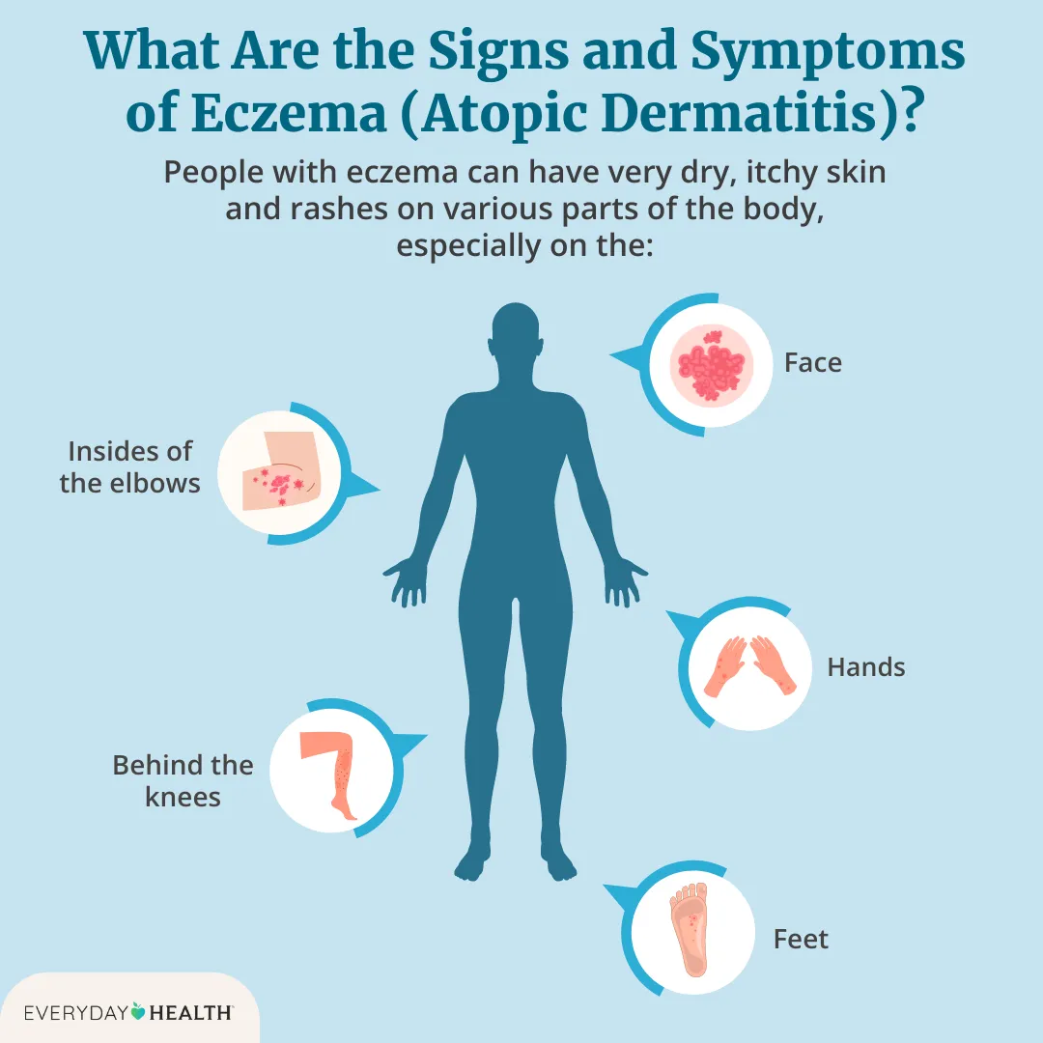
WHAT IS ECZEMA?
Eczema, also known as dermatitis, is a chronic inflammatory skin condition that causes the skin to become:
Dry
Red
Itchy
Sensitive
Sometimes cracked or oozing
It is a long-term condition that can flare up periodically and is influenced by genetics, immune system sensitivity, skin barrier dysfunction, and environmental triggers.

Slide 3



How many people are affected by it?
230 million people worldwide suffer from atopic dermatitis.
Around 15–20% of children and 7–10% of adults have eczema.
In the Netherlands, around 2.5% of the population has atopic eczema

Slide 4
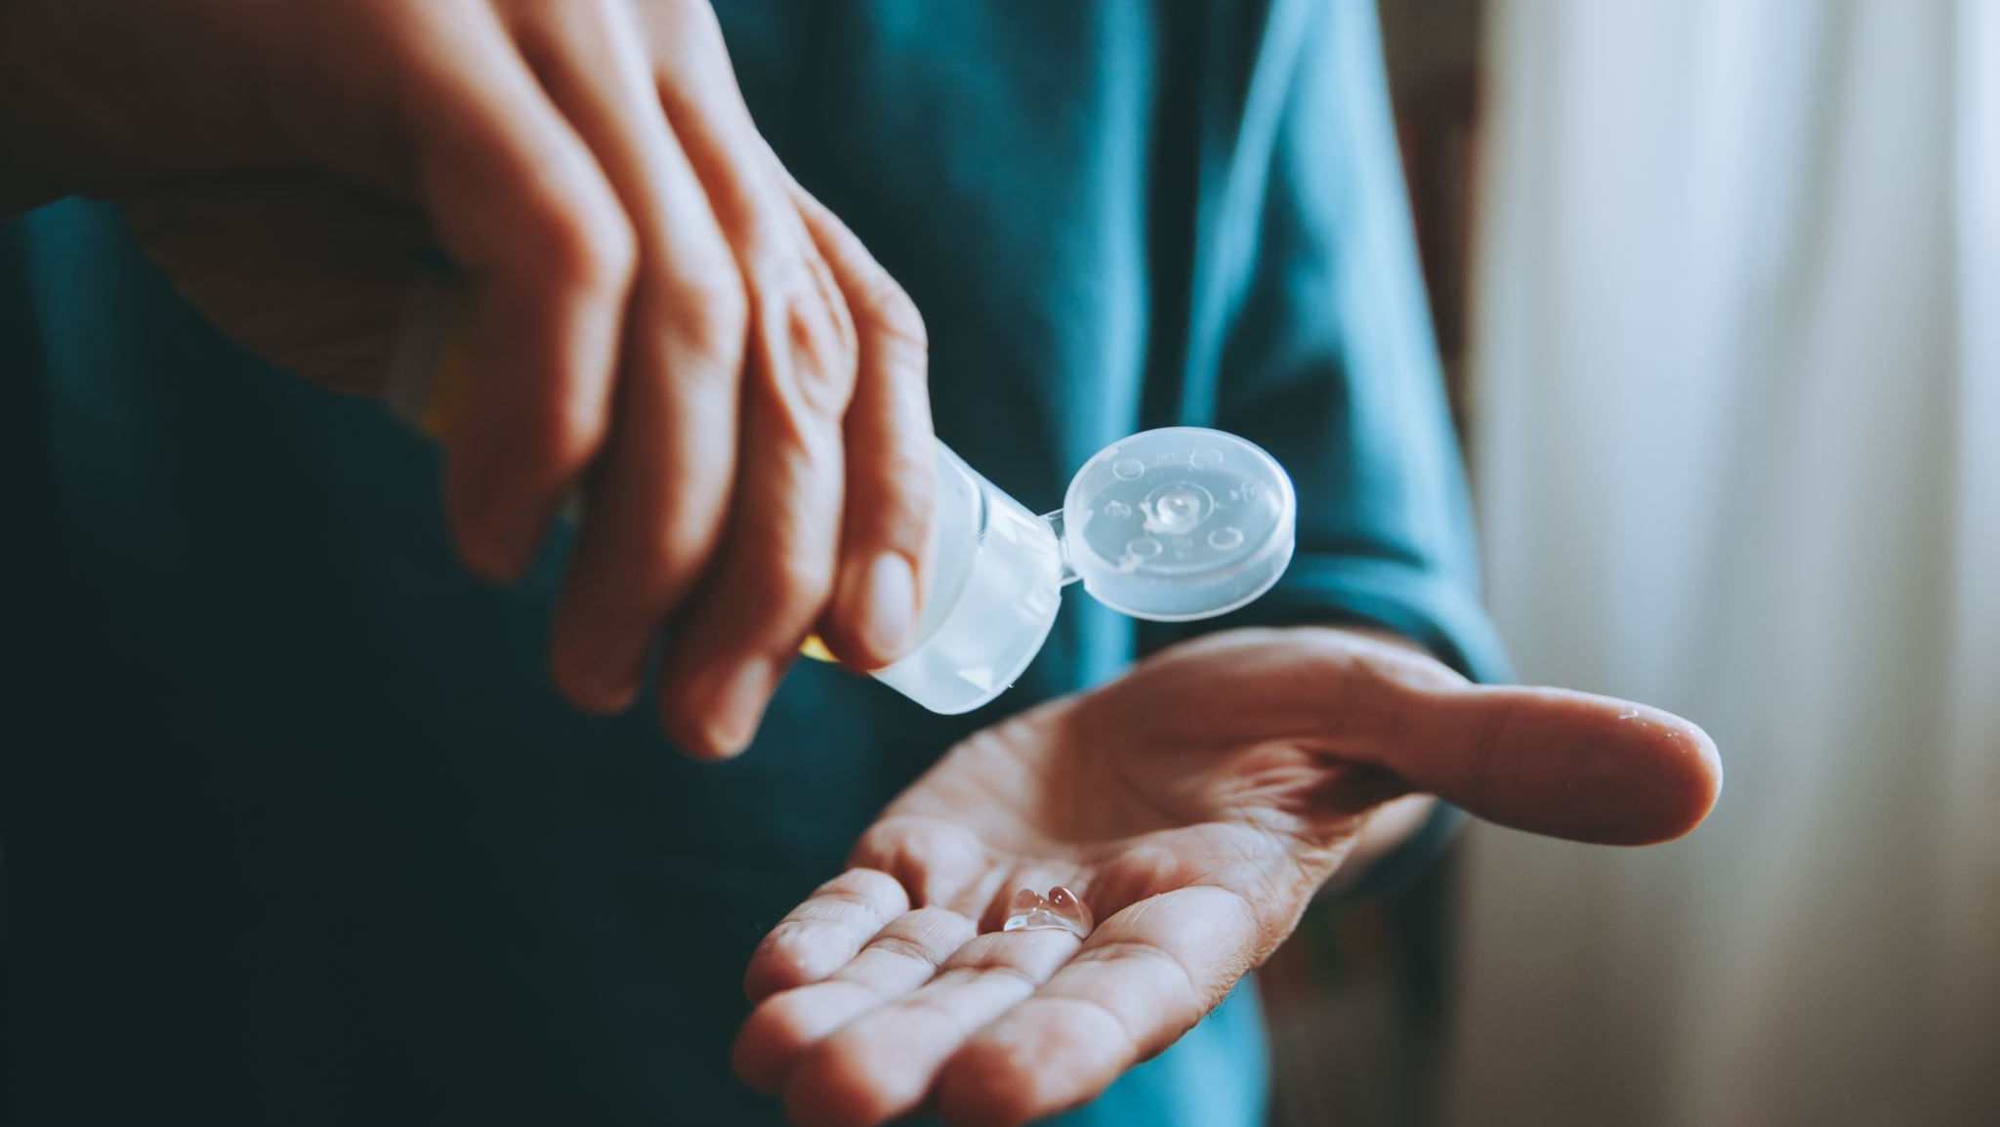
What Is the Problem?
Eczema is not just a skin rash , it affects physical, emotional, and social well-being.
Daily Symptoms: itchiness, painful flare ups, sleepless nights..
Psychological Impact: stress and anxiety, social withdrawal..
Treatment Challenges: No cure- Treatment..
Healthcare Burden: Frequent visits to doctors

Slide 5
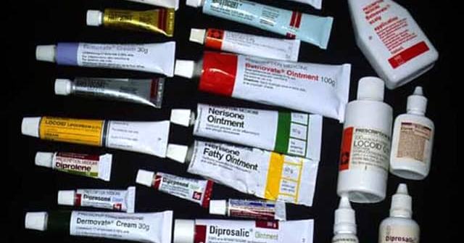
What is the solution?
Eczema is treated frequently with steroid creams that can cause side effects or lead to TSW (Topical Steroid Withdrawal) if overused. This is another condition worse than eczema.
Eczema can also be influenced by various triggers such as weather, stress, allergens, food, and skin products. However, doctors often recommend steroid creams as the first solution without conducting further testing.
That’s why I want to create a reliable tool for identifying the severity of the eczema and predict if the eczema will flare depending the environment.

Slide 6
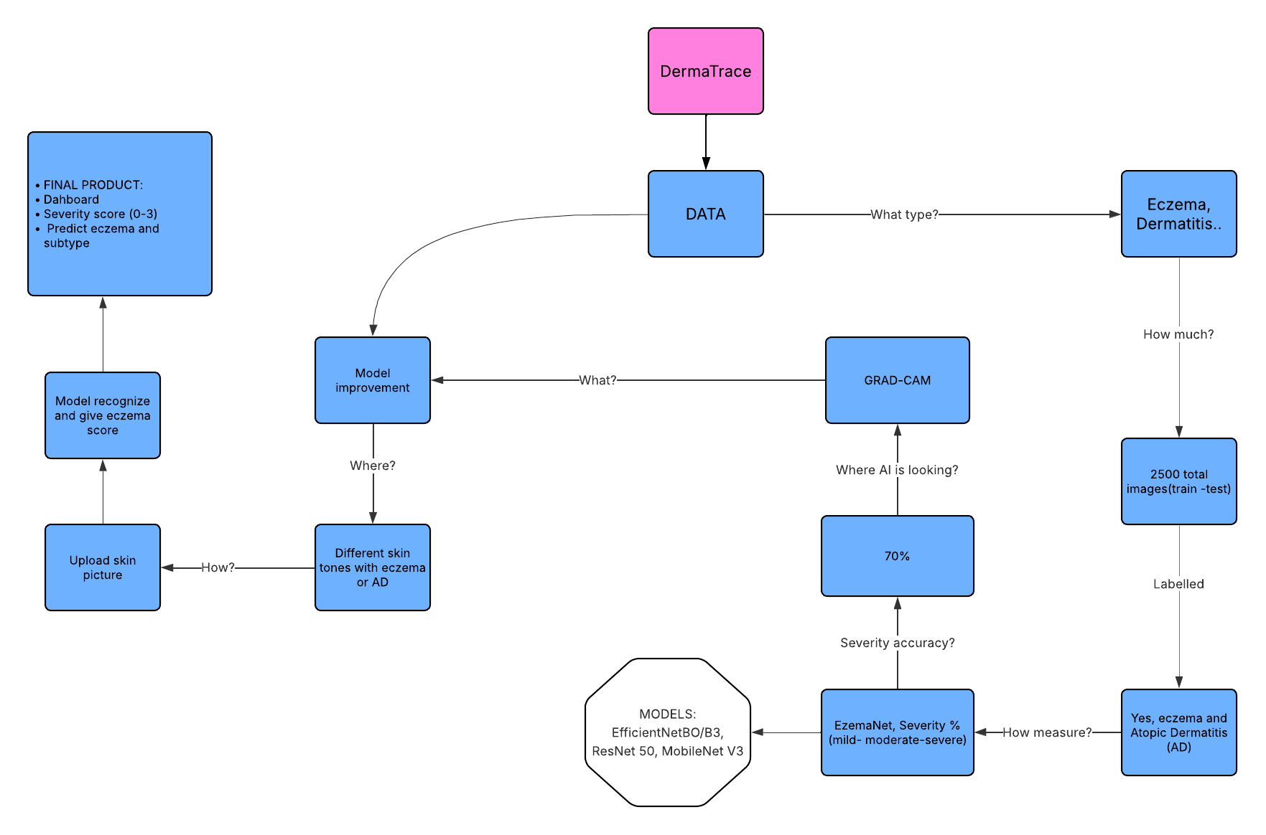
How will DermaTrace be structured?

Slide 7
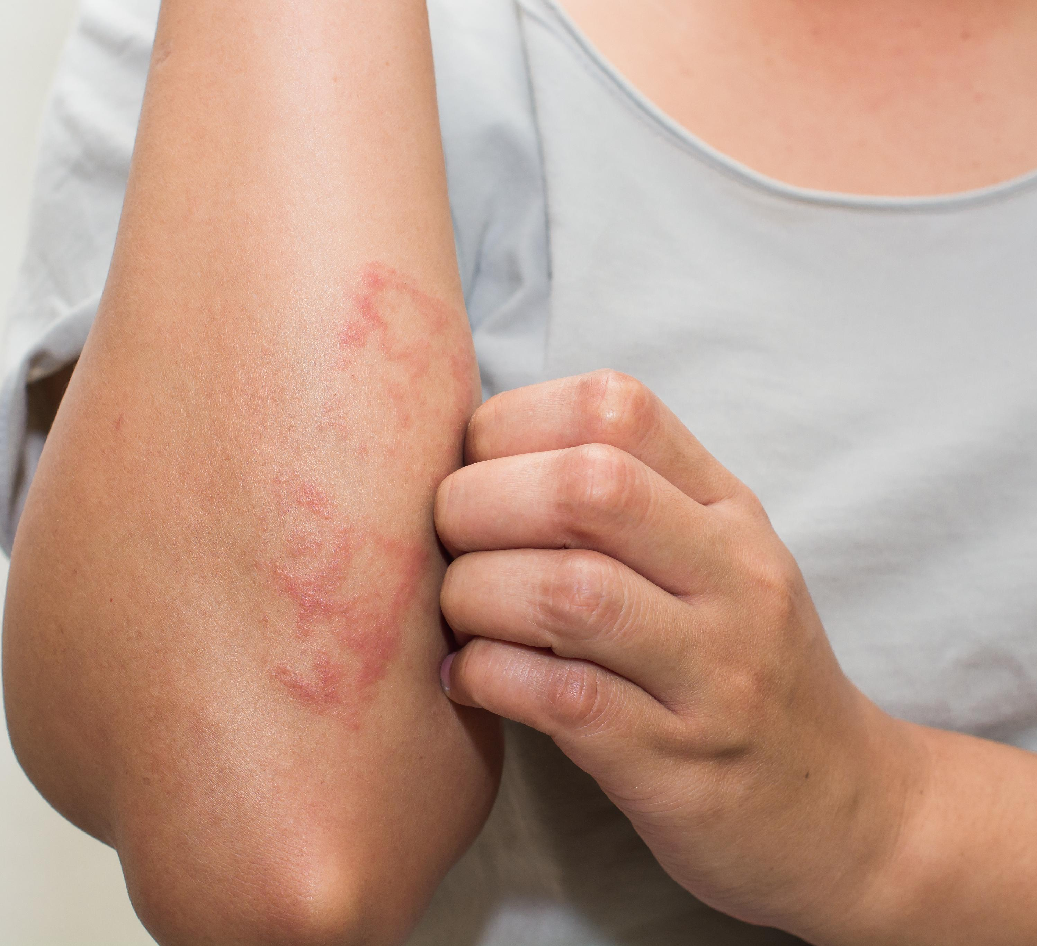
First Peer Review:
What I did so far?
Search for meaningful datasets with eczema, atopic dermatitis photos
Experimenting ONLY with test dataset
Data exploring about labelling of pictures
Preprocessing of images
Experimenting with models that can process medical images:
ResNet50
InceptionV3
DenseNet121

Slide 8
Next Steps:
Next Steps:
Collect an additional dataset with skin tones similar to mine
(Using my own photos as part of the validation set).
This is important because eczema appears differently across skin tones in both color and texture.
Preprocess the images
Crop the photos and test whether detection accuracy improves or decreases when focusing only on the affected areas.
Experiment with different CNN architectures : Train multiple model heads that classify: body parts, type of eczema, skin tone to build a robust model
After training, use Grad-CAM to check whether the model is correctly identifying the eczema regions.

Slide 9
Status update- DC Coach review
Steps followed until now:
Step 1 – Data Preprocessing
Step 2 - Model Architecture
Step 3 – Model Training & Evaluation
Step 4 – Error Analysis
Step 5 – Explainability (Grad-CAM)
Step 6 - Model improvement
6.1. Class weights
6.2. Threshold tuning
6.3. Final Grad-Cam after threshold tuning

Slide 10
Status update- DC Coach review (next steps)
Research background and documentation:
Eczema vs Atopic Dermatitis
EczemaNet model
Steps taken during the project (data preprocessing, modelling and evaluation)
Future improvements:
Use of more diverse images:
Metadata integration
  Severity
  Lighting conditions
  Skin type
Multi-stage classification approach
  Step 1: Eczema vs Non-eczema
  Step 2: Eczema subtype classification
  Final Reflection & Conclusion/ DEMO

